Slide 1
Probability & Random Processes EE2011 Department of Electrical Engineering
NATIONAL UNIVERSITY OF COMPUTER & EMERGING SCIENCES, LAHORE CAMPUS

Slide 2
2.4 Probability of an event
To ﬁnd the probability of an event A, what should we do?
We sum all the probabilities assigned to the sample points in A.
This sum is called the probability of A and is denoted by P(A).
In many experiments, such as tossing a coin or a die, all the sample elements or points have the same chance of occurring and are assigned equal probabilities.

Slide 3
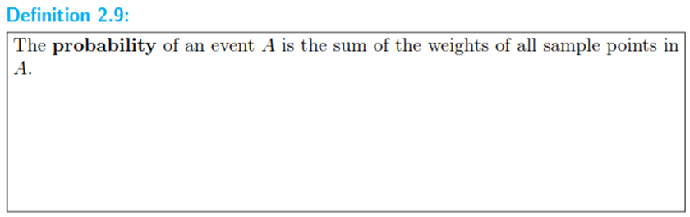




Slide 4







Slide 5




Slide 6






Slide 7
Probability of an event
If the sample space for an experiment contains N elements, all of which are equally likely to occur,
we assign a probability equal to 1/N to each of the N (points) elements.
The probability of any event A containing n of these N sample (points) elements
is then the ratio of
the number of elements in A to the number of elements in S.

Slide 8
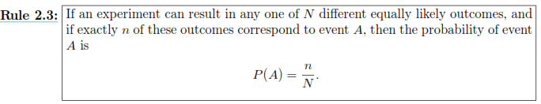




Slide 9
Probability of an Event
If the outcomes of an experiment are not equally likely to occur,
the probabilities must be assigned on the basis of prior knowledge or experimental evidence.
For example, if a coin is not balanced,
we could estimate the probabilities of heads and tails
by tossing the coin a large number of times and recording the outcomes
According to the relative frequency deﬁnition of probability,
the true probabilities would be the fractions of heads and tails that occur in the long run.

Slide 10
Probability of an Event
Another intuitive way of understanding probability is the indiﬀerence approach
For instance, if you have a die that you believe is balanced,
then using this indiﬀerence approach,
you determine that the probability that each of the six sides will show up after a throw is 1/6

Slide 11
Probability of an event
To ﬁnd a numerical value that represents adequately the probability of winning at tennis,
we must depend on our past performance at the game
as well as that of the opponent and,
to some extent, our belief in our ability to win.
Intuition would undoubtedly also play a part in determining the size of the bet that we might be willing to wager.
The use of intuition,
personal beliefs,
and other indirect information in arriving at probabilities
is referred to as the subjective deﬁnition of probability.

Slide 12
Probability of an event
In most of the applications of probability in this book,
the relative frequency interpretation of probability is the operative one
Its foundation is the statistical experiment rather than subjectivity,
and it is best viewed as the limiting relative frequency
As a result, many applications of probability in science and engineering
must be based on experiments that can be repeated

Slide 13
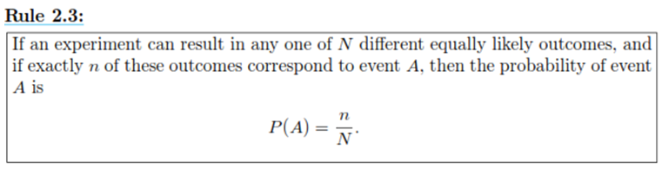
Many ways to assign probability of occurrence of the sample points of a sample space.
The use of intuition, personal beliefs, and other indirect information in arriving at probabilities is referred to as what?
the subjective deﬁnition of probability
The indifference approach assume probabilities to be what?
equally likely
does not use subjectivity or intuition
Relative frequency interpretation of probability is defined as follow:

Slide 14
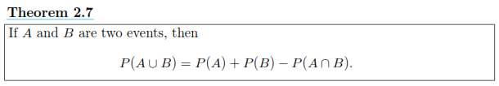
2.5 Additive Rule
Often it is easiest to calculate the probability of some event from known probabilities of other events
This may well be true if the event in question can be represented as the union of two other events
or as the complement of some event
Several important laws that frequently simplify the computation of probabilities follow
The ﬁrst, called the additive rule, applies to unions of events

Slide 15
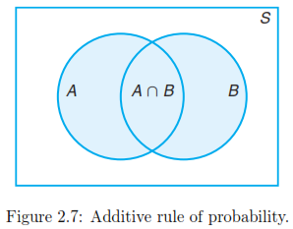


Slide 16



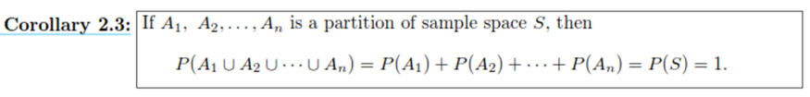

Slide 17
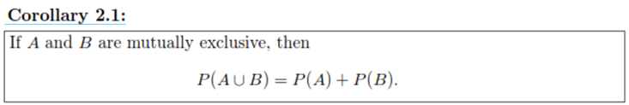
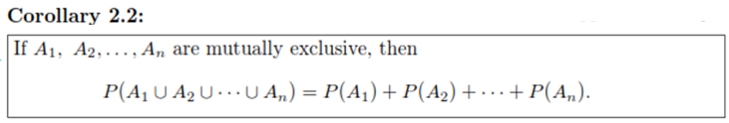
Corollaries 2.1 and 2.2 suggest the very intuitive result
dealing with the probability of occurrence of at least one of a number of events,
no two of which can occur simultaneously.
The probability that at least one occurs
is the sum of the probabilities of occurrence of the individual events.

Slide 18
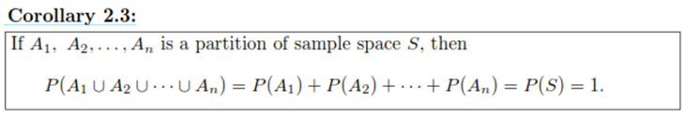
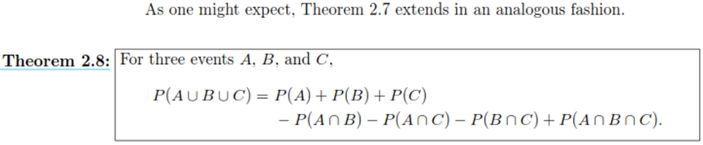
The third corollary simply states that the highest value of a probability (unity) is assigned to the entire sample space S.

Slide 19



Slide 20


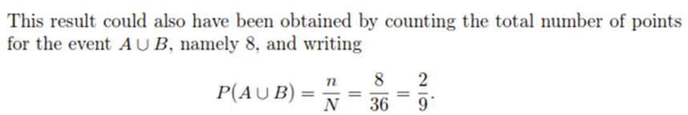

Slide 21

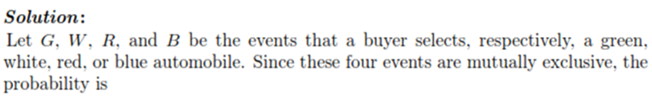


Slide 22
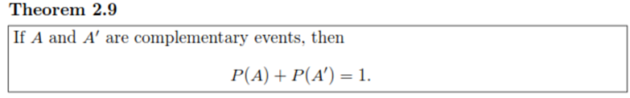





Often it is more diﬃcult to calculate the probability that an event occurs than it is to calculate the probability that the event does not occur.
Should this be the case for some event A, we simply ﬁnd P(A’) ﬁrst and then, using Theorem 2.7, ﬁnd P(A) by subtraction.

Slide 23
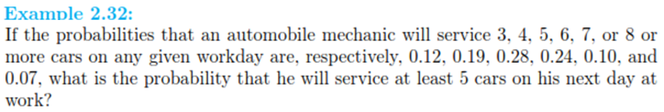



Slide 24

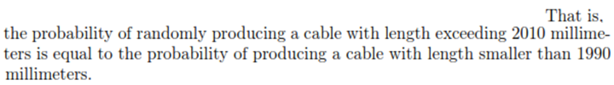

Slide 25





Slide 27


Slide 28




Slide 29




